Slide 1
Cognitive Works

Slide 2
02
01
03
Table of context
04
Solution
Ethics
Problem
Metrics
05
06
Used Technologies
Our Team

Slide 3
Problem and idea
Choosing the right skincare products can be overwhelming due to the vast number of options available.
-Consumers often spend significant time researching ingredients, reviews, and suitability for their specific skin type.

Slide 4
Solution
Our product aims to simplify the process of finding the right skincare routine by reducing the need for extensive research and making personalized skincare guidance more accessible to everyone.

Slide 5
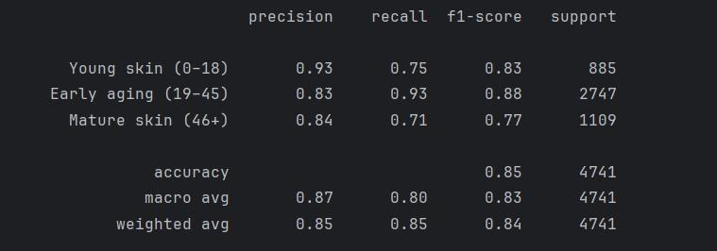
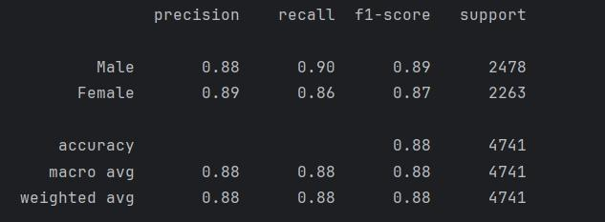
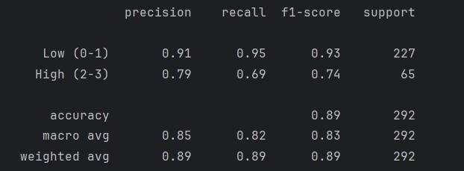
Metrics
Age classifier
Gender classifier
Acne severity classifier

Slide 6
Ethics
User selfies:
Get deleted immediately after use
Never get saved to any databases
Are never passed through any APIs/external services
Now lets move to the site

Slide 7






Used Technologies
Now lets move to the site

Slide 8


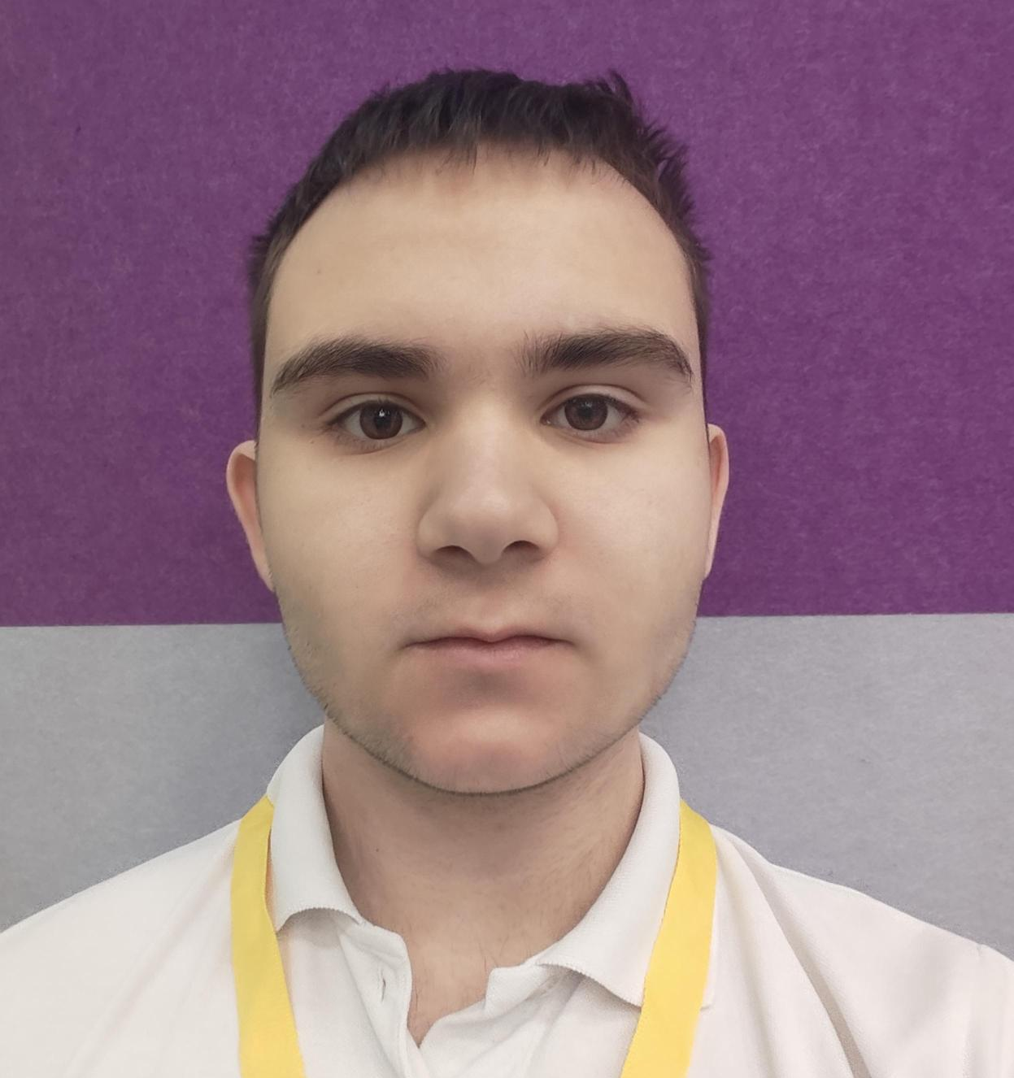
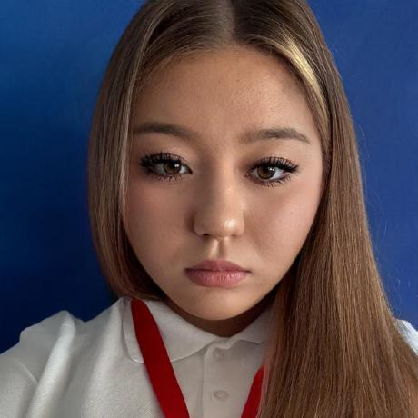
02
03
01
Table of context
Idea
Metrics
02
Team
Our Team
Stefan Radev
Zlatin Lazarov
Nikolay Zhelyazkov
Taiana Kovacheva
Back-end Developer
Back-end Developer
Front-end Developer
Researcher / Designer

